Slide 1
Title (Preferable Font : Helvetica, size: 42-60*)
Affiliation
logo
Author
Affiliation
* Depending on your title length; minimum font size 28
Jan 8-10, 2019, Hotel Trident, Chennai

Slide 2
Background/Introduction/Rationale
Add your first bullet point here
Add your second bullet point here
Add your third bullet point here
Strict to six points, use font size 24 (minimum); 36 (maximum)
Use bullet points & high contrast colours to emphasis important points
Avoid all CAPITAL LETTERS
Jan 8-10, 2019, Hotel Trident, Chennai

Slide 3
Aim/Objective
Based on introduction Aim/objective may be defined.
Strict to 3-4 points.
One slide is expected for this section.
Precise & concise objectives are expected.
Usage of graphics/pictures is encouraged. (if it is easy to convey the objectives)
Jan 8-10, 2019, Hotel Trident, Chennai

Slide 4
Methodology/Experimental set-up
Flow charts/ schemes- explaining the methods are preferable.
Conditions/ parameters may be mentioned here.
Equations pertaining to the study (if needed may be included eg., conversion of SCE to RHE etc.)
Preferably one slide for methodology.
Avoid including chemicals/brand name etc.,
Precise & concise details are preferred.
Jan 8-10, 2019, Hotel Trident, Chennai

Slide 5
Results and Discussion
Preferably 2-3 slides for Results and Discussion.
Include maximum of 4 images per slide.
Use of images (results) is expected rather than text.
Use minimum resolution of 600 dpi images with bold lines along with appropriate units.
Avoid low resolution images.
Jan 8-10, 2019, Hotel Trident, Chennai

Slide 6
Results and Discussion
Jan 8-10, 2019, Hotel Trident, Chennai

Slide 7
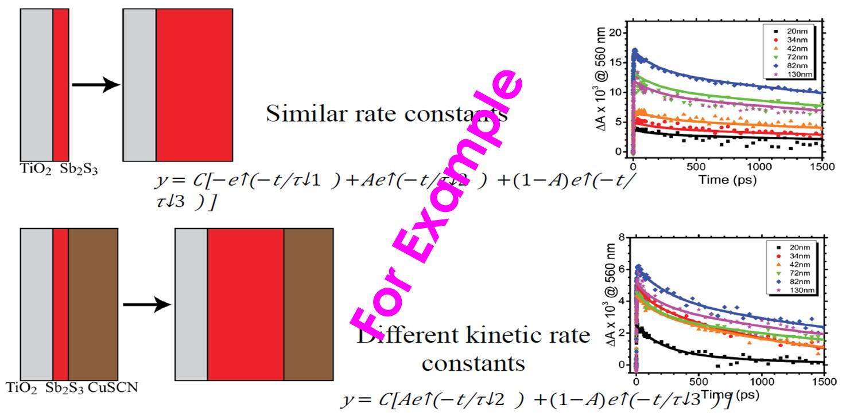
Results and Discussion
Jan 8-10, 2019, Hotel Trident, Chennai

Slide 8
Conclusions
Restrict to 4-6 points.
Highlight your novel findings with existing Literature.
Jan 8-10, 2019, Hotel Trident, Chennai

